Slide 1

Coursera IBM Data Science Capstone Project: Opening a new Indian Restaurant in Toronto Report
Madhuri

Slide 2
Business Problem
The objective of this capstone project is to find the most suitable location for the entrepreneur to open a new Indian restaurant in Toronto, Canada.
By using data science methods and machine learning methods such as clustering, this project aims to provide solutions to the business question: In Toronto, if an entrepreneur wants to open an Indian restaurant, where should they consider opening it?

Slide 3
Data:
List of neighborhoods in Toronto, Canada.
Latitude and Longitude of these neighborhoods.
Venue data related to Asian restaurants. This will help us find the neighborhoods that
are most suitable to open an Indian restaurant.

Slide 4
Extracting the Data
Scrapping of Toronto neighborhoods via Wikipedia
Getting Latitude and Longitude data of these neighborhoods via Geocoder package
Using Foursquare API to get venue data related to these neighborhoods

Slide 5
Methodology
extracting the list of neighborhoods from Wikipedia page
Web scraping by utilizing pandas html table scraping method
Use Four Square to get Venue data
Filter the data
Use K means clustering
Visualize he clusters in a map

Slide 6
Results
Cluster 0: Neighborhoods with little or no Indian restaurants
Cluster 1: Neighborhoods with low Indian restaurants
Cluster 2: Neighborhoods with high number of Indian restaurants

Slide 7
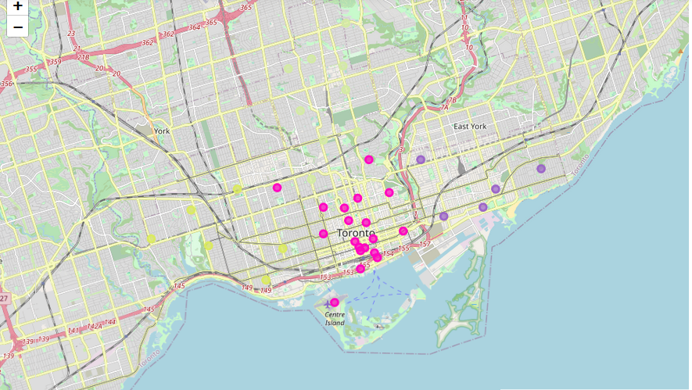
Results
Cluster 0: Neighborhoods with little or no Indian restaurants
Cluster 1: Neighborhoods with low Indian restaurants
Cluster 2: Neighborhoods with high number of Indian restaurants

Slide 8
Conclusion
In this project, we have gone through the process of identifying the business problem,
specifying the data required, extracting and preparing the data, performing the machine
learning by utilizing k-means clustering and providing recommendation to the stakeholder.
References:
List of neighborhoods in Toronto:
https://en.wikipedia.org/wiki/List_of_postal_codes_of_Canada:_M

